Slide 1


Slide 2
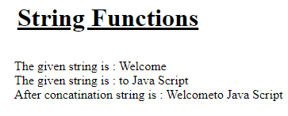
<html>
<head> <title> Strings </title></head>
<body>
<h1 align=center><u> String Functions </u></h1>
<script language="JavaScript">
var a = window.prompt(" Entet any string");
document.writeln(" The given string is : ",a);
var b = window.prompt(" Entet any string");
document.writeln(" <br> The given string is : ",b);
var c = a.concat(b);
document.writeln(" <br> After concatination string is : ",c);
</script>
</bdoy>
</html>

Slide 3
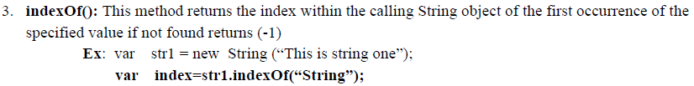

Slide 4
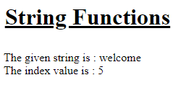
<html>
<head> <title> Strings </title></head>
<body>
<h1 align=center><u> String Functions </u></h1>
<script language="JavaScript">
var a = window.prompt(" Enter any string");
document.writeln(" The given string is : ",a);
var b = window.prompt(" Enter which string index you want ");
var c = a.indexOf(b);
document.writeln(" <br> The index value is : ",c);
</script>
</bdoy>
</html>

Slide 5
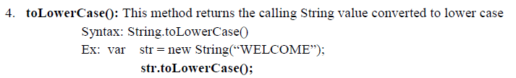

Slide 6
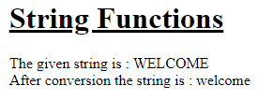
<html>
<head> <title> Strings </title></head>
<body>
<h1 align=center><u> String Functions </u></h1>
<script language="JavaScript">
var a = window.prompt(" Enter any string in Capital letters ");
document.writeln(" The given string is : ",a);
var c = a.toLowerCase();
document.writeln(" <br> After conversion the string is : ",c);
</script>
</bdoy>
</html>

Slide 7
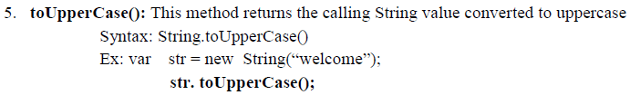

Slide 8
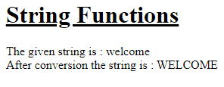
<html>
<head> <title> Strings </title></head>
<body>
<h1 align=center><u> String Functions </u></h1>
<script language="JavaScript">
var a = window.prompt(" Enter any string in small letters ");
document.writeln(" The given string is : ",a);
var c = a.toUpperCase();
document.writeln(" <br> After conversion the string is : ",c);
</script>
</bdoy>
</html>

Slide 9
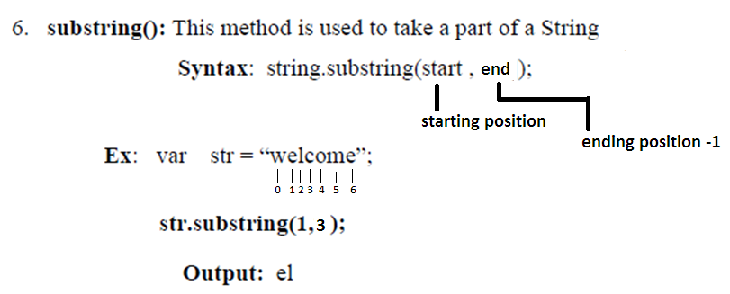

Slide 10
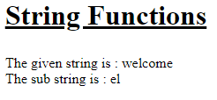
<html>
<head> <title> Strings </title></head>
<body>
<h1 align=center><u> String Functions </u></h1>
<script language="JavaScript">
var a = window.prompt(" Enter any string ");
document.writeln(" The given string is : ",a);
var c = a.substring(1,3);
document.writeln(" <br> The sub string is : ",c);
</script>
</bdoy>
</html>

Slide 11
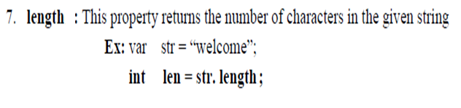

Slide 12
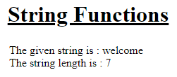
<html>
<head> <title> Strings </title></head>
<body>
<h1 align=center><u> String Functions </u></h1>
<script language="JavaScript">
var a = window.prompt(" Enter any string ");
document.writeln(" The given string is : ",a);
var c = a.length;
document.writeln(" <br> The string length is : ",c);
</script>
</bdoy>
</html>

Slide 13
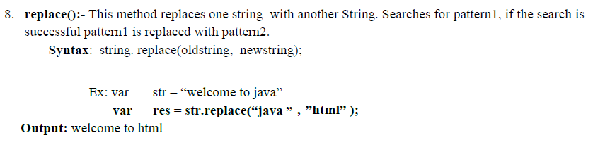

Slide 14
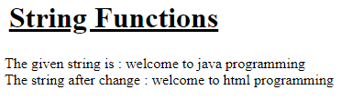
<html>
<head> <title> Strings </title></head>
<body>
<h1 align=center><u> String Functions </u></h1>
<script language="JavaScript">
var a = window.prompt(" Enter any string ");
document.writeln(" The given string is : ",a);
var c = a.replace("java","html");
document.writeln(" <br> The string after change : ",c);
</script>
</bdoy>
</html>

